Slide 1


Let it Bloom
A BlooMap Project
Notes:
Ariel

Slide 2

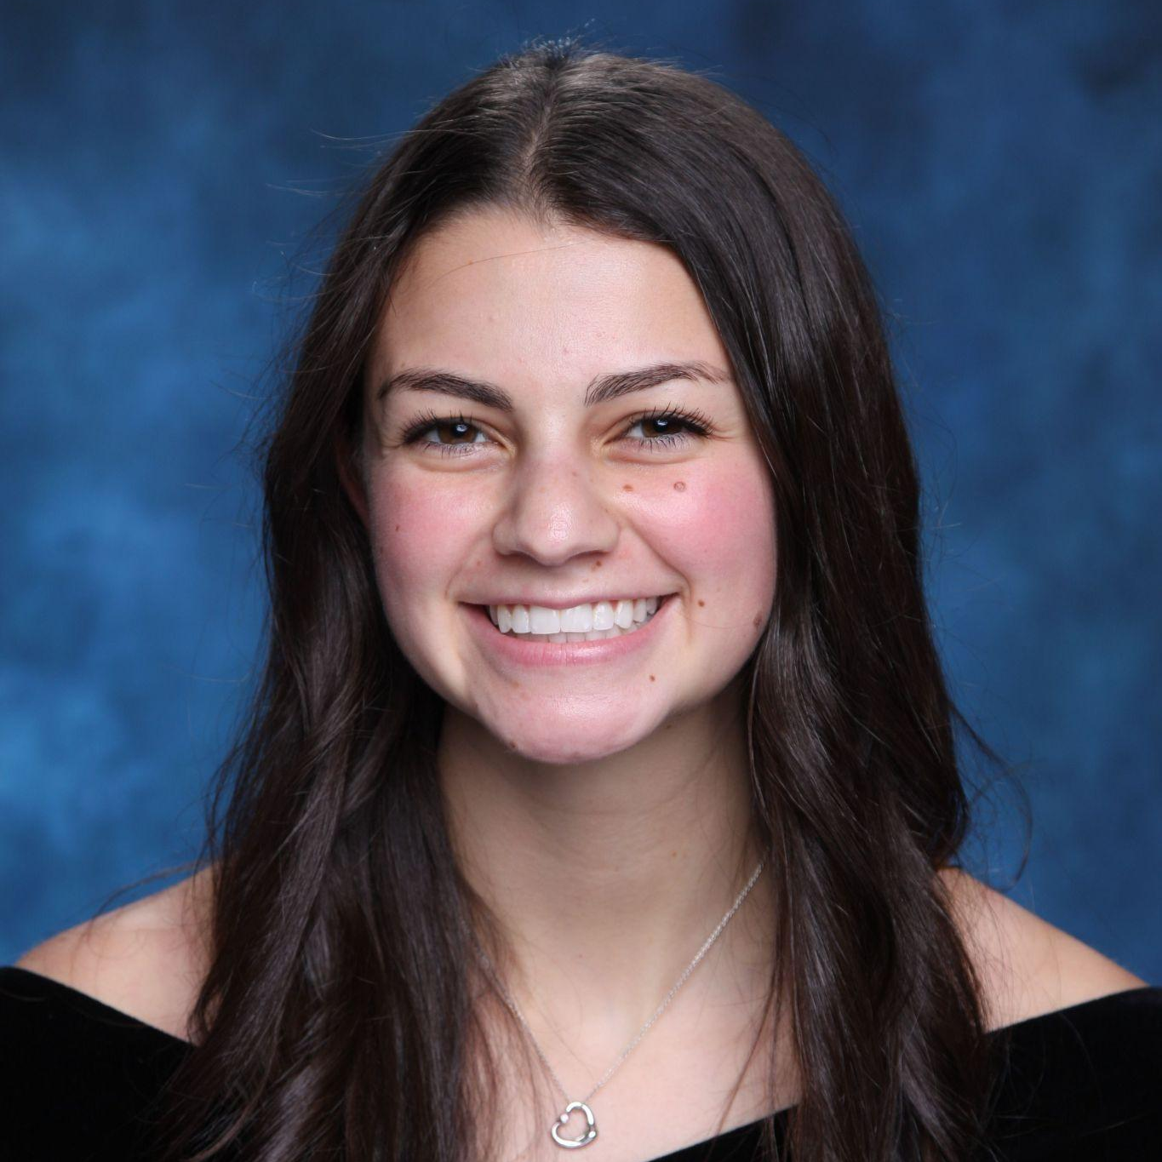


Our Team
Joshua Cohen Project Manager
Maya Pollack Team Member
Ariel Monson Team Member
Talia David Team Member

Slide 3
What is BlooMap?
Company utilizing an AI engine
Provides correlations between specific plants and environmental conditions
Creating the Let it Bloom app
Notes:
Ariel
Bloomap uses existing resources and information
with user generated data to develop an AI engine.
This engine provides precise coordination between specific plants and site-specific environmental conditions as well as providing relevant cultivation and growing information. Bloomap is creating an app which helps users choose plants for their specific zip code.

Slide 4
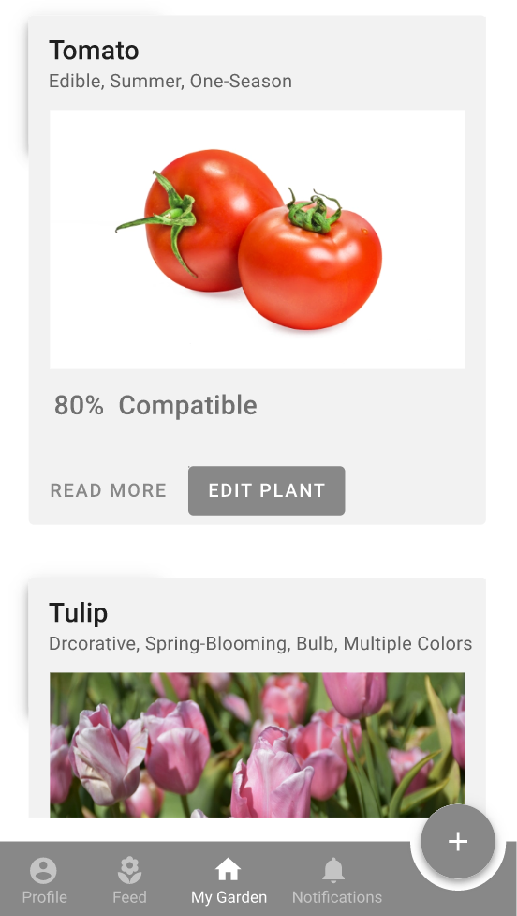
Let it Bloom App
Interactive UI
Compatibility
My Garden
Notes:
Ariel

Slide 5
Phases
Koppen-Geiger Classifications
1
Plant Hardiness Zones
2
Plant Web-Scraping
3
Notes:
Ariel

Slide 6
1. Koppen Geiger Classifications
Notes:
Maya
The Koppen Geiger Classifications divides climates into five main climate groups across the world such as tropical, dry, or temperate.

Slide 7
Our Process
Given:
Text files containing coordinates and climate zones for each of five climate forecast models
Goal:
Convert each file to a CSV
Steps:
Used Google Colab to upload text files, convert them, and organize the new CSVs.
Notes:
Maya
Basically we were given text files which gave us coordinates and climate zones to the five climate models. We converted each file into a CSV using google collab to allow our point of contact to plug the data into her database.

Slide 8
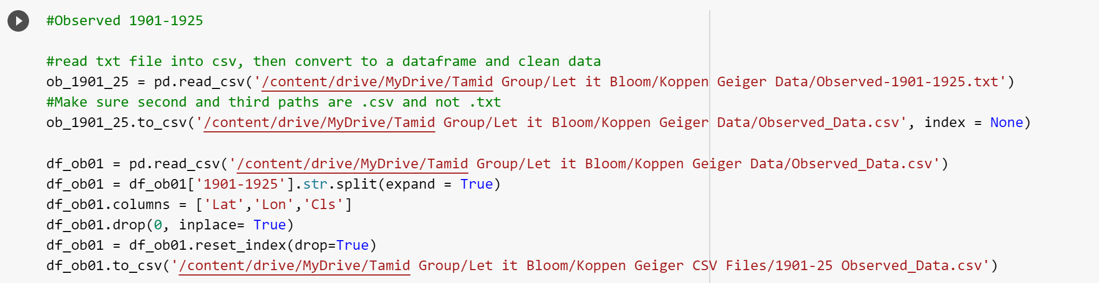
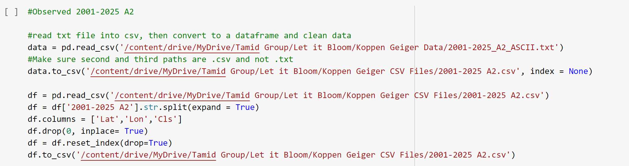
Our Code
Notes:
Maya
Our code! This is an example of how we split up the data to give to our point of contact.

Slide 9
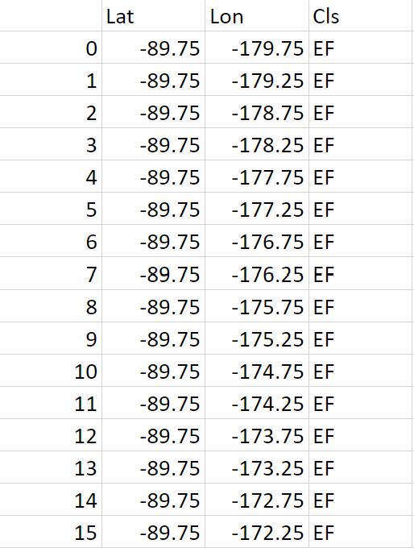
Our Results
20 CSVs
Organized by climate model and time period
Notes:
Maya
Our results gave us 20 data frames that look like this - the data frames contain latitude, longitude, and climate zone

Slide 10
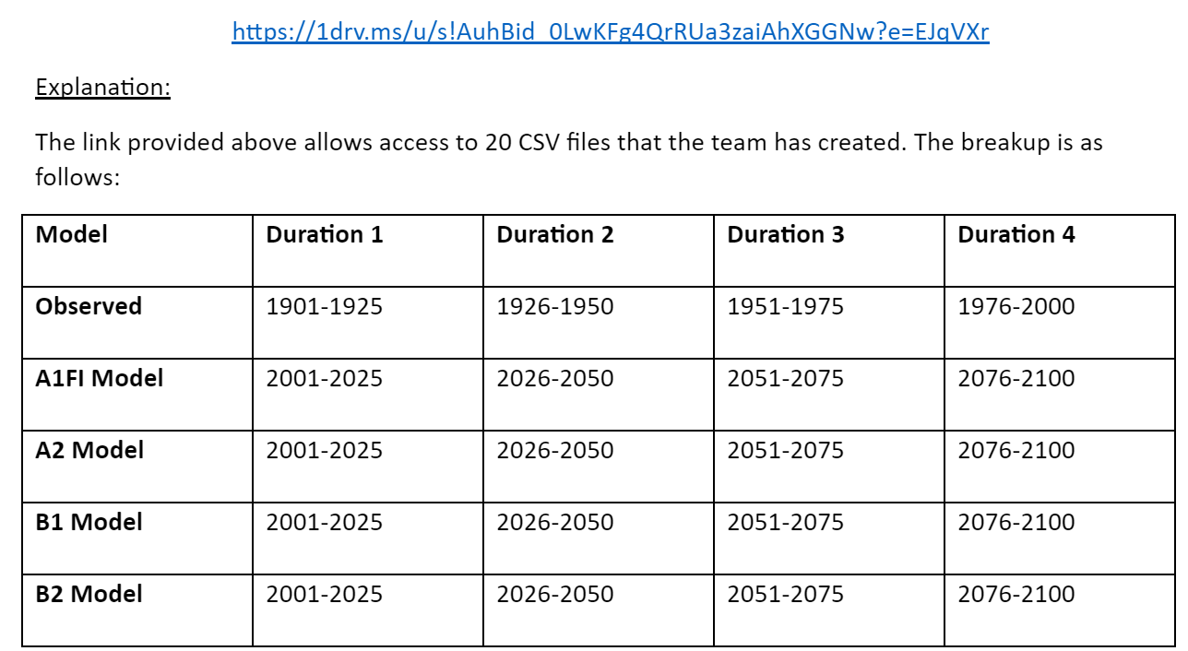
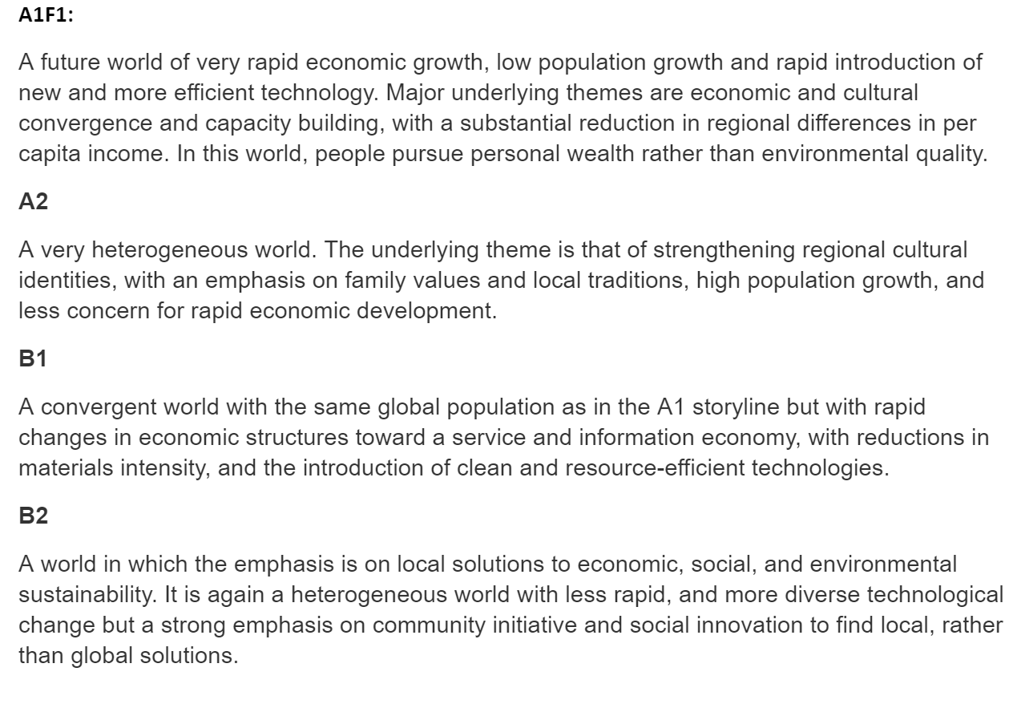
Phase 1 Deliverable
Notes:
Maya
We gave our point of contact a link with all of the CSV’s which contain the climate data and broke it down with explanations of each model.

Slide 11
2. Plant Hardiness Zones
Notes:
Josh

Slide 12
Our Process
Given:
CSV file containing zip codes and plant hardiness zone
Goal:
Convert each zip code to coordinates
Match with climate zone
Steps:
Used a geolocator to convert zip codes
Pandas to match data frames
Notes:
Josh

Slide 13
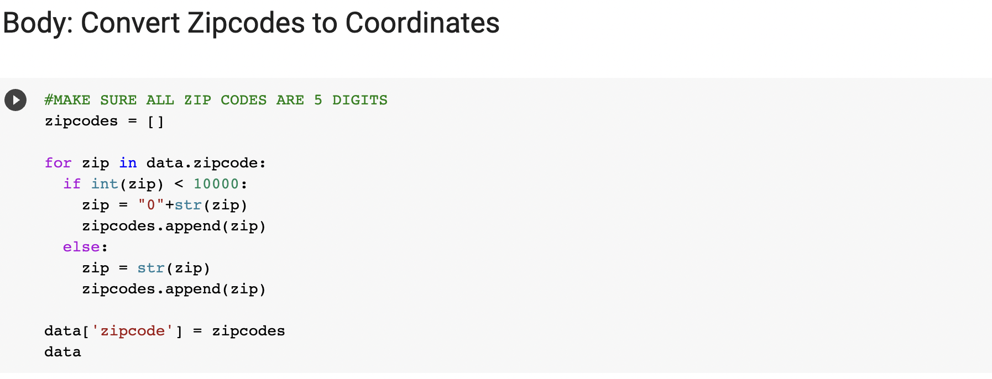
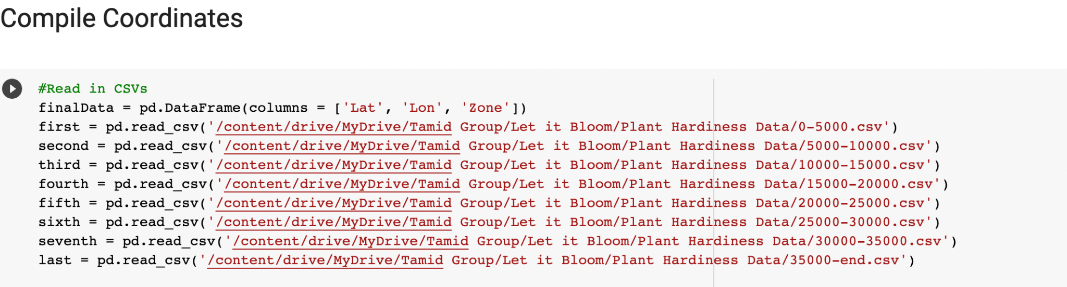
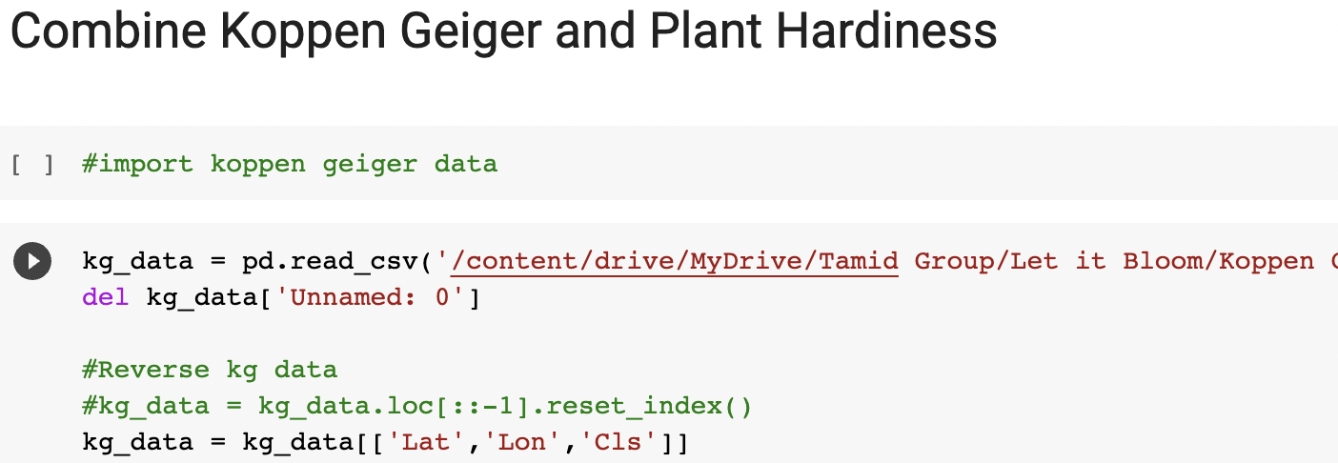
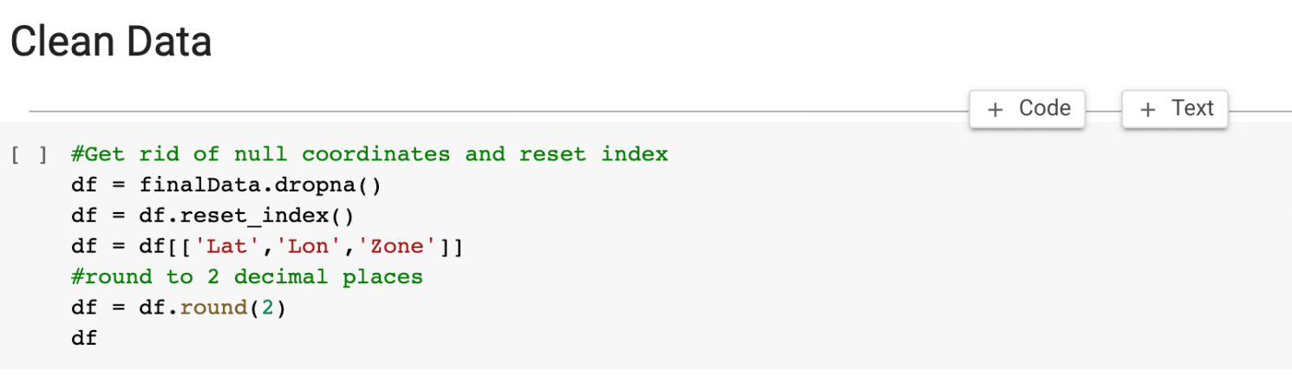
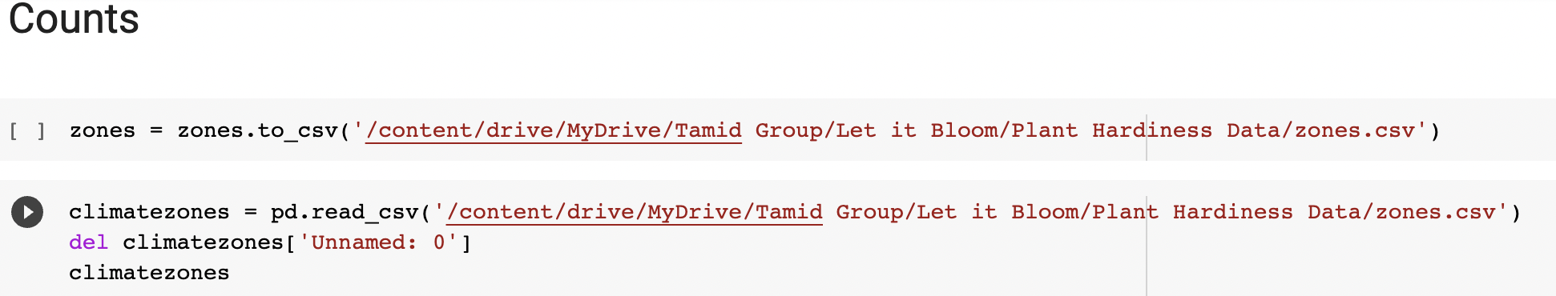
Our Code
Notes:
Josh

Slide 14
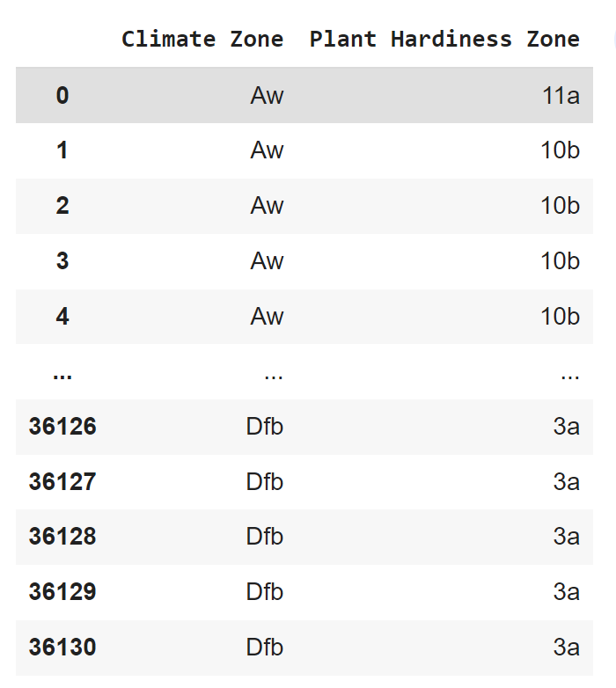
Our Results
Dataframe matching climate zones with plant hardiness zones
Notes:
Josh

Slide 15
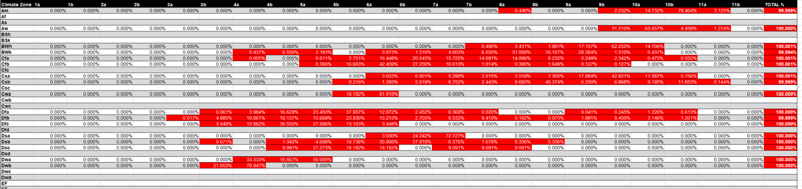
Phase 2 Deliverable
Details the makeup of each climate zone in terms of plant hardiness zone
Ex: Climate Zone A is 85% Plant Hardiness Zone B, 15% C
Notes:
Josh

Slide 16
3. Plant Web-Scraping
Notes:
Josh

Slide 17
Our Process
Given:
A website detailing 1000+ plants with data about each
Goal:
Create a CSV file detailing each plant and its data
Steps:
Used BeautifulSoup web scraping
Notes:
Josh

Slide 18
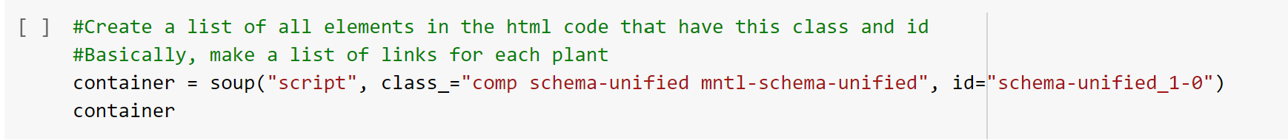
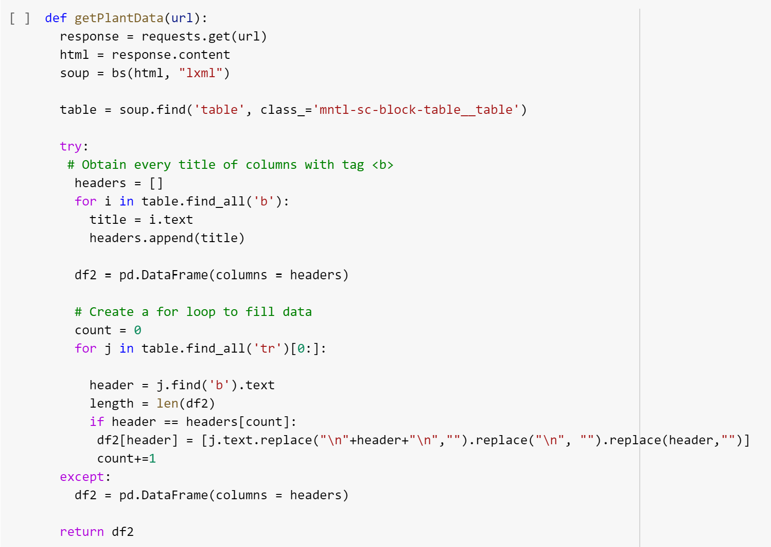
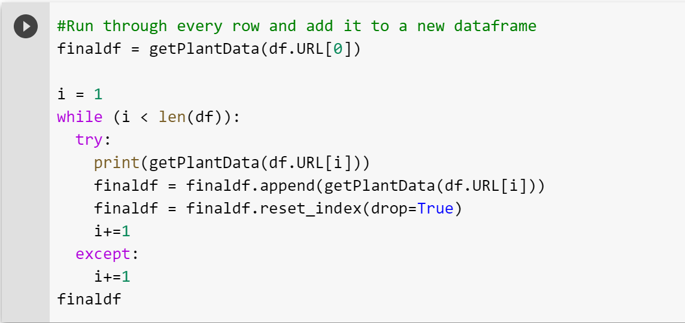
Our Code
Notes:
Josh

Slide 19
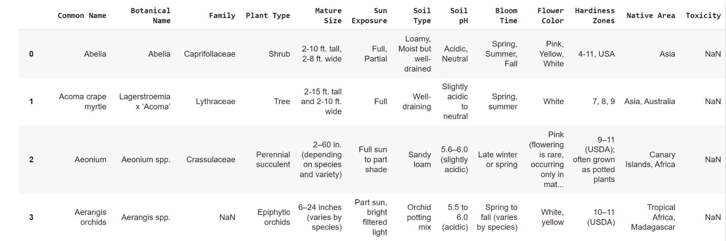
Phase 3 Deliverable
Notes:
Josh

Slide 20
Big Picture
Each deliverable is plugged into the Let it Bloom database to help support the back end of their app
Then users can enjoy the app!
Notes:
Talia

Slide 21
Any Questions?
Notes:
Talia

